Slide 1




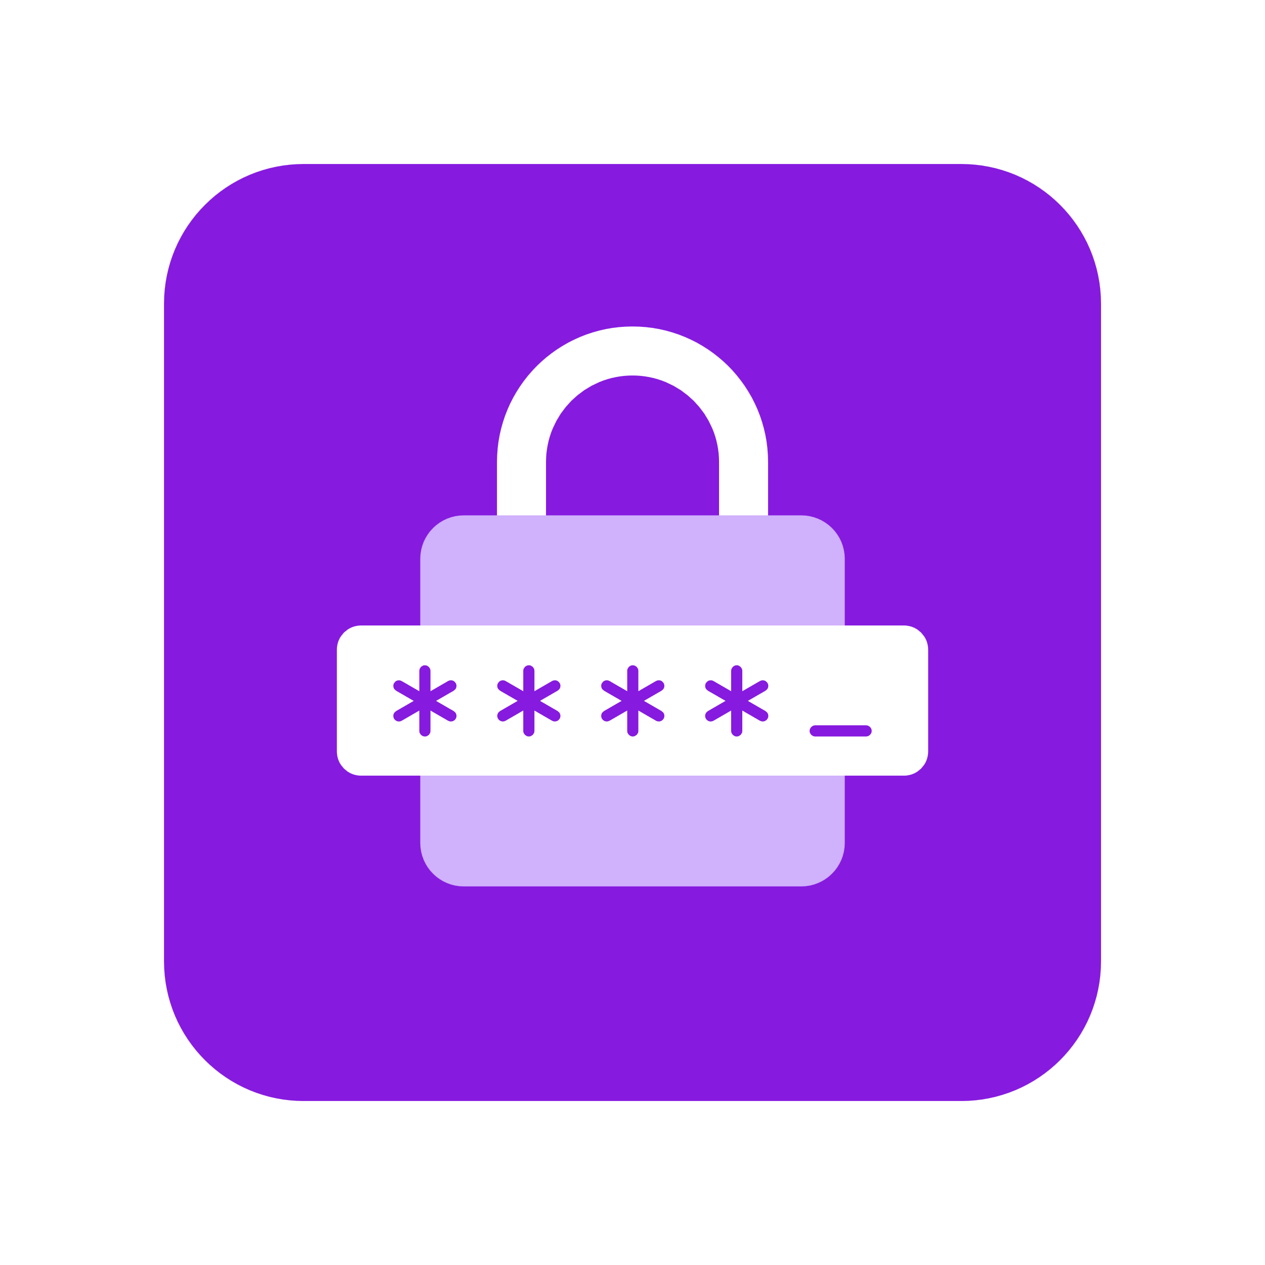

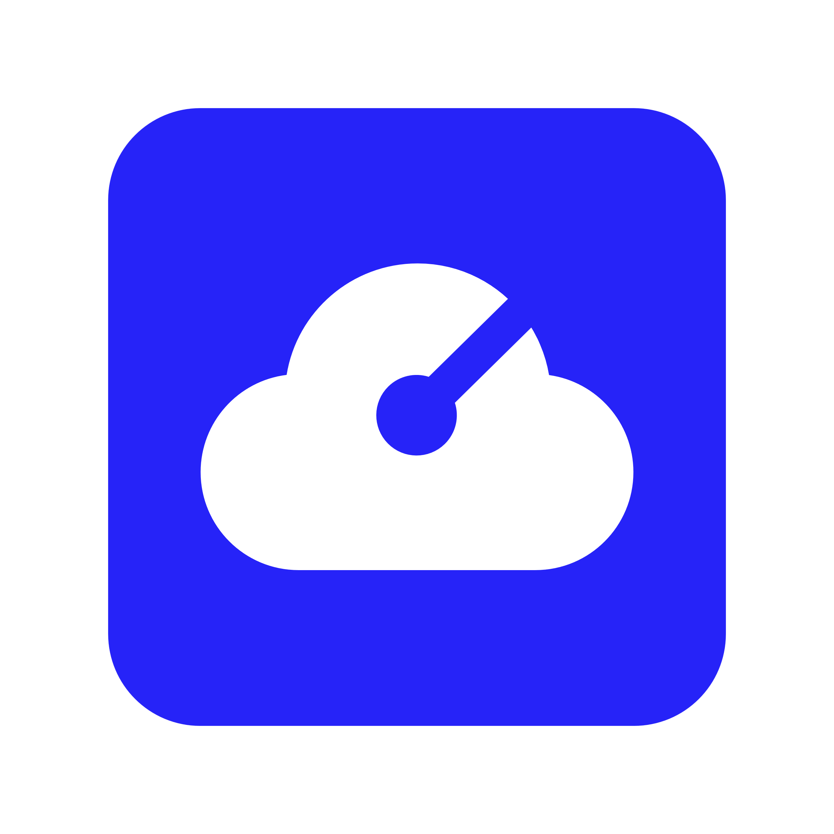

Branding Guidelines
The following icons & assets can be used for your own diagrams. Please don’t edit the designs/colors of the icons. For any questions reach out at aka.ms/radius/discord
Environment
Application
Container
Portable
Resource
Secret Store
Recipe
Gateway
Grouping
Connection
Logos & Logomark

Slide 2
Building and Operating Cloud Native Platforms with Radius
Will Velida, Lead Software Engineer @ Mantel Group
@willvelida

Slide 3
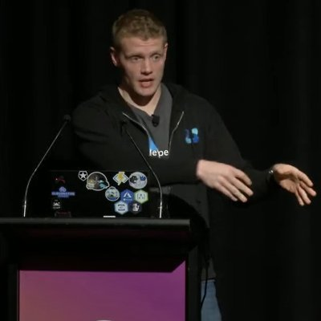
$ whoami?
Lead Software Engineer at Mantel Group.
Microsoft Azure MVP based in Melbourne.
Community Organizer.
Public Speaker.

Slide 4
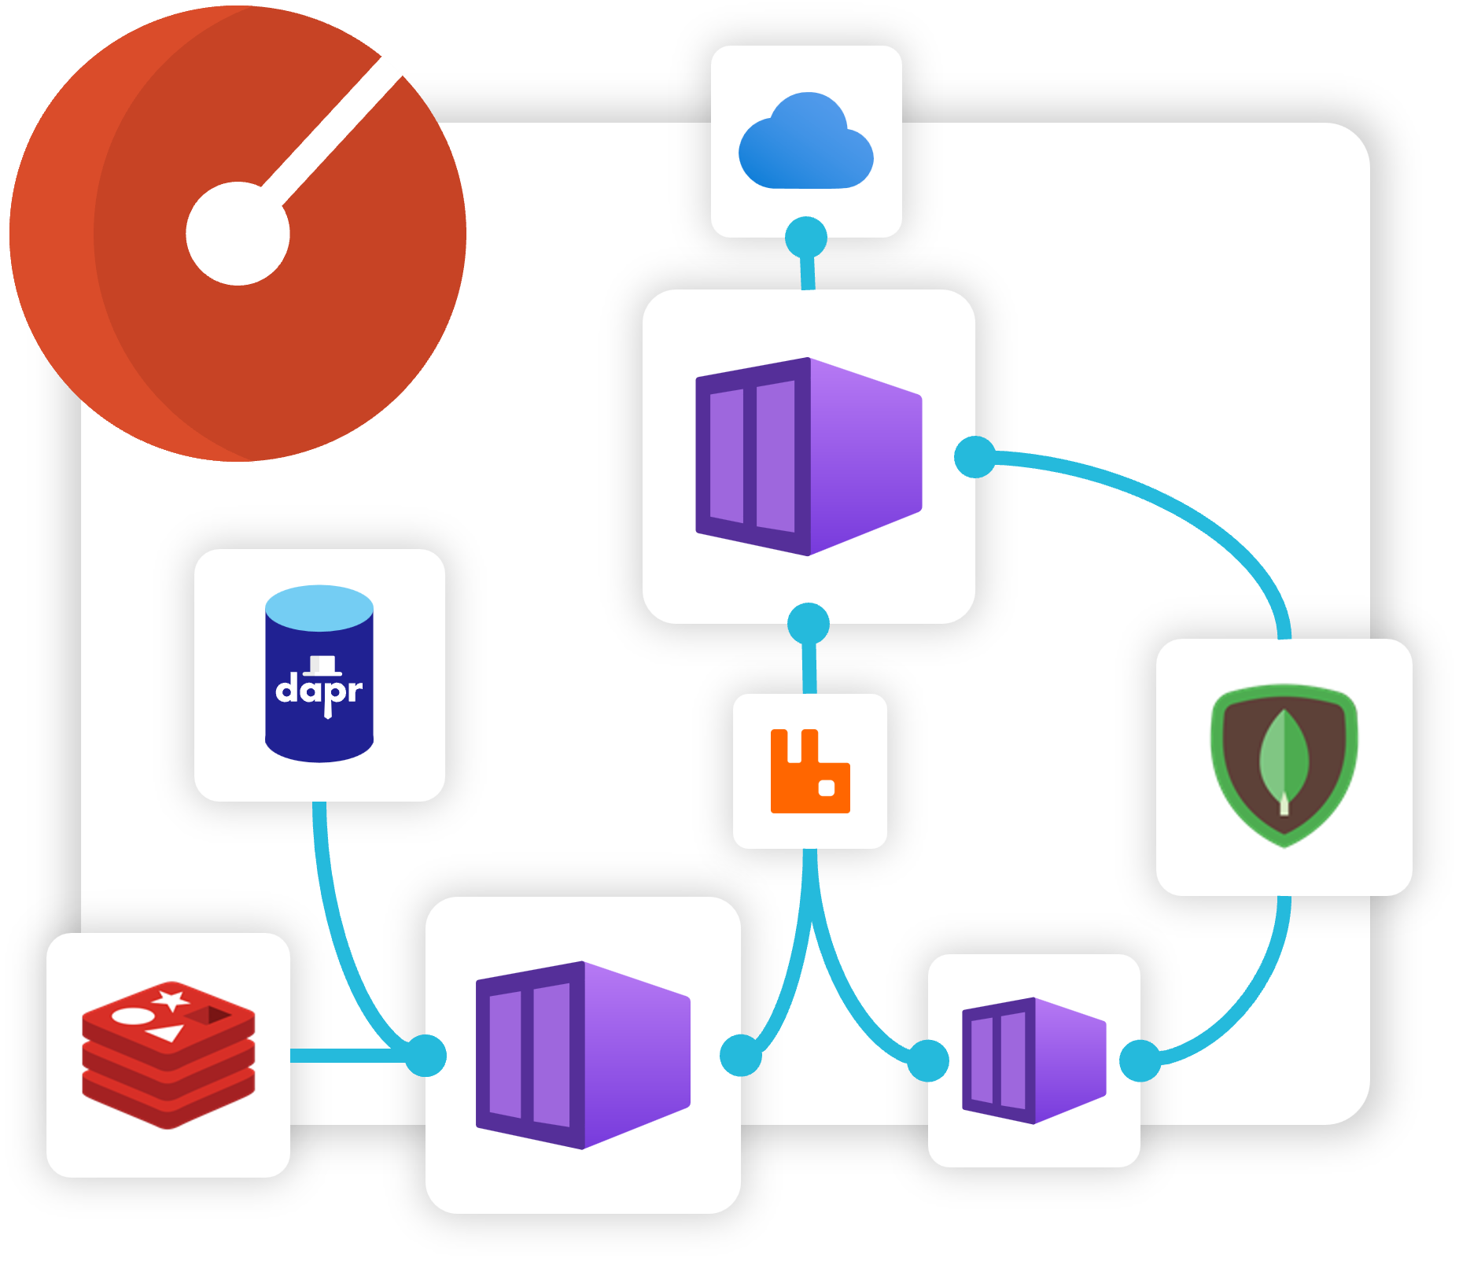
Agenda
What is Radius?
Radius Applications
Recipes
Environments
Demo

Slide 5



Why is building and running Cloud Native apps hard?
Complex architectures
Cross-platform portability
Enforcing
best-practices
Troubleshooting
experiences
Notes:
1. Complex Architectures:
Cloud-native applications are typically built using microservices, containers, and serverless architectures, all of which add layers of complexity.
Each component is loosely coupled but must work together seamlessly. This means that designing the interactions and ensuring smooth communication between services becomes challenging.
Managing dependencies between services, versioning APIs, and ensuring that the system remains scalable and resilient can also be tricky.
Moreover, understanding and implementing distributed systems effectively requires a specific skill set that not all teams have.
2. Cross-platform Portability:
One of the promises of cloud-native is that applications can be deployed on any cloud provider or hybrid environments without changes to the underlying code.
However, ensuring portability between different cloud providers and environments often leads to platform-specific configurations and customizations, which can defeat the purpose.
While Kubernetes and containerization help to abstract some of these differences, managing configurations across different environments (e.g., dev, staging, prod) still poses challenges.
Each platform might have slightly different networking, storage, and security models, adding to the complexity.
3. Enforcing Best Practices:
Adhering to cloud-native best practices like 12-factor app methodology, Infrastructure as Code (IaC), and immutable infrastructure is crucial, but it's not always straightforward.
Teams often struggle with consistency—one part of the system might follow best practices, while another part doesn't, leading to technical debt.
Automating these practices across teams requires tools, processes, and often cultural changes, which take time to embed.
Ensuring governance around security, compliance, and cost optimization also requires careful planning and monitoring.
4. Troubleshooting Experiences:
With cloud-native applications, you’re dealing with a dynamic, distributed system where services are running across multiple containers, clusters, and regions.
Identifying the root cause of an issue often involves sifting through logs from different sources, tracing requests across services, and sometimes even dealing with ephemeral infrastructure.
Traditional monitoring tools may not provide the depth or visibility required to track down problems in such complex systems, so there’s a growing need for observability tools that help visualize and trace the complete system.
Even with these tools, diagnosing and fixing problems can be time-consuming and require deep expertise.

Slide 6
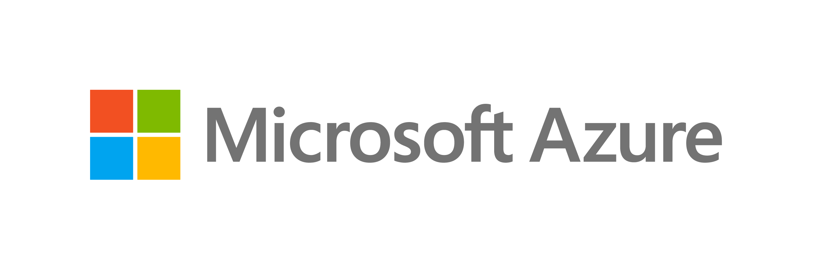
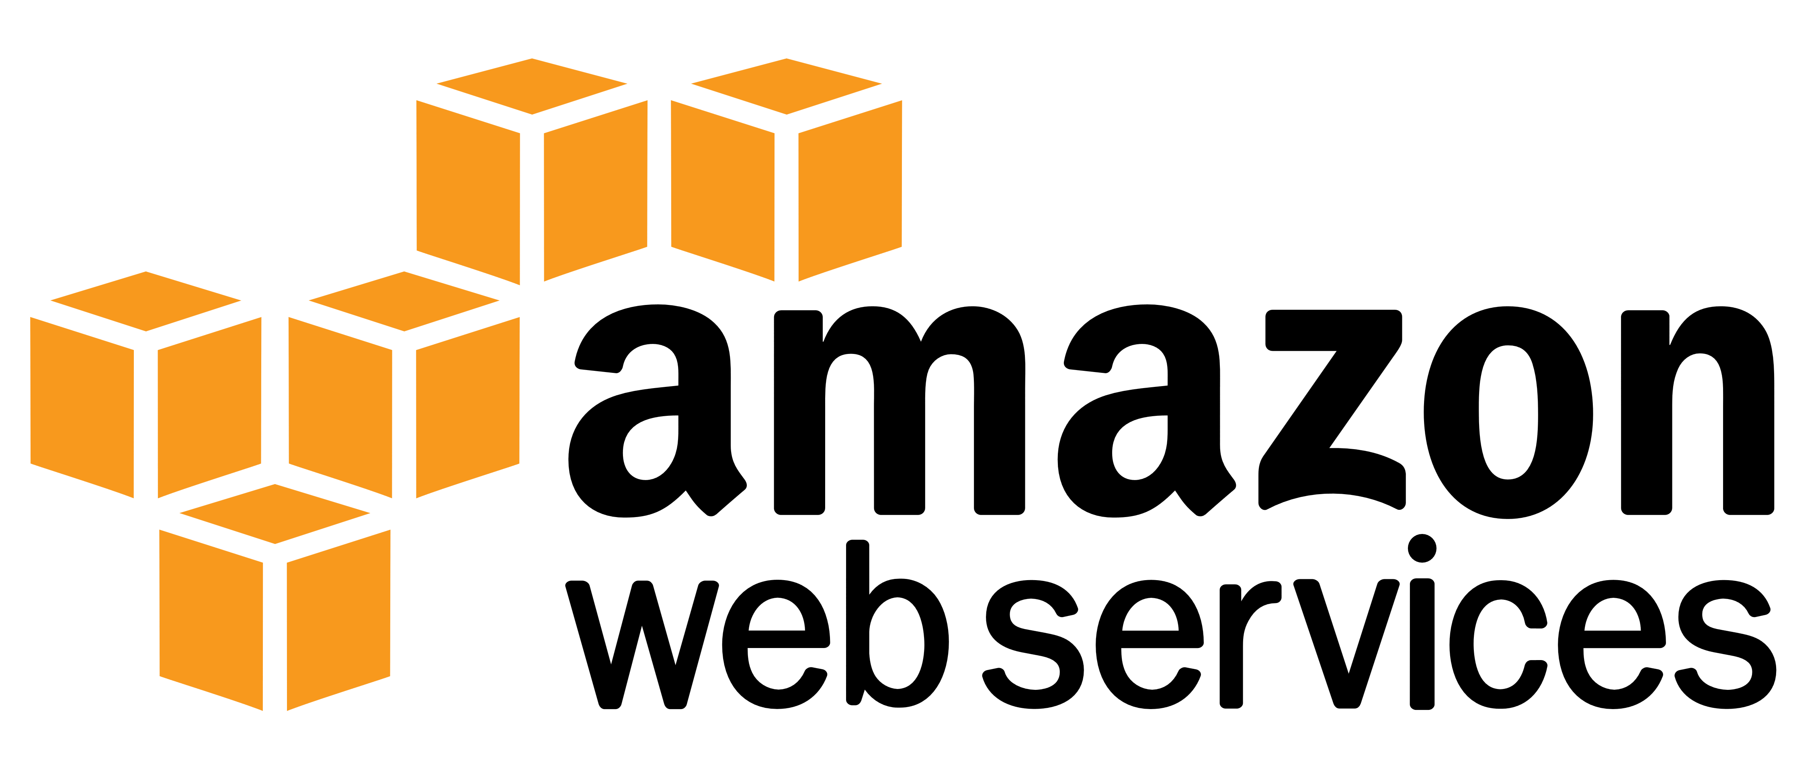

Standardized “app” layer across platforms
On-premises
Complex architectures
Cross-platform portability
Enforcing
best-practices
Troubleshooting
experiences
Notes:
- Standardizing on Kubernetes has been successful for most enterprises, but this does come with more complexity than it’s worth. We also don’t just run our apps on Kubernetes. Maintaining and operating all our resources in our application is a full time job.

Slide 7




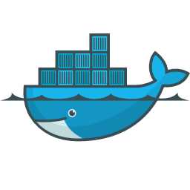
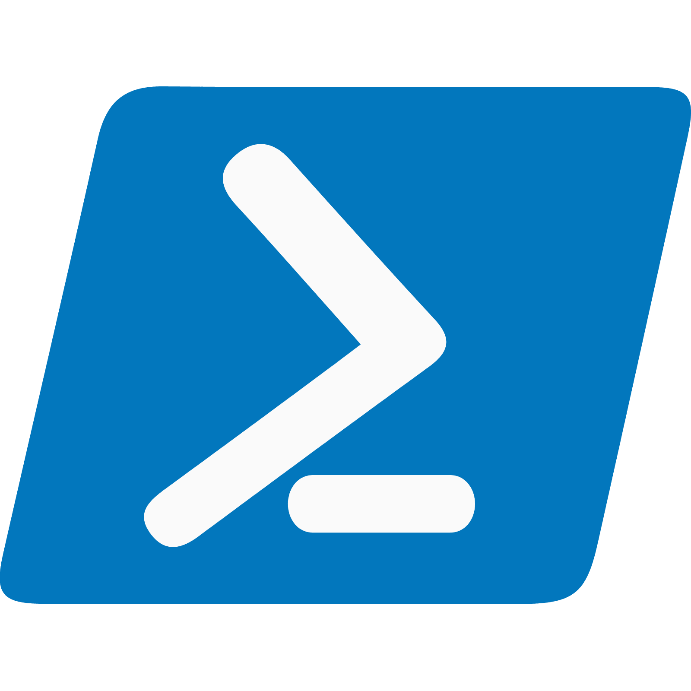



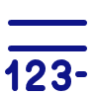

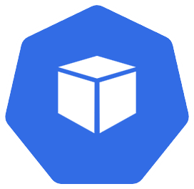

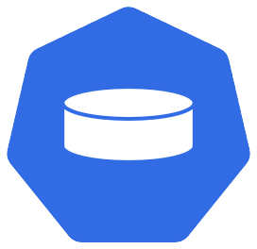
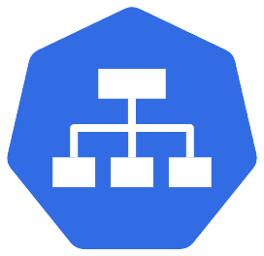


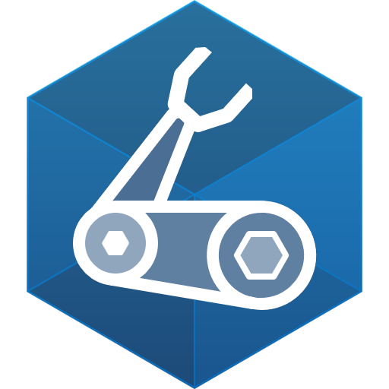
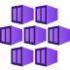
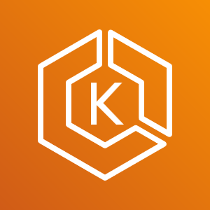







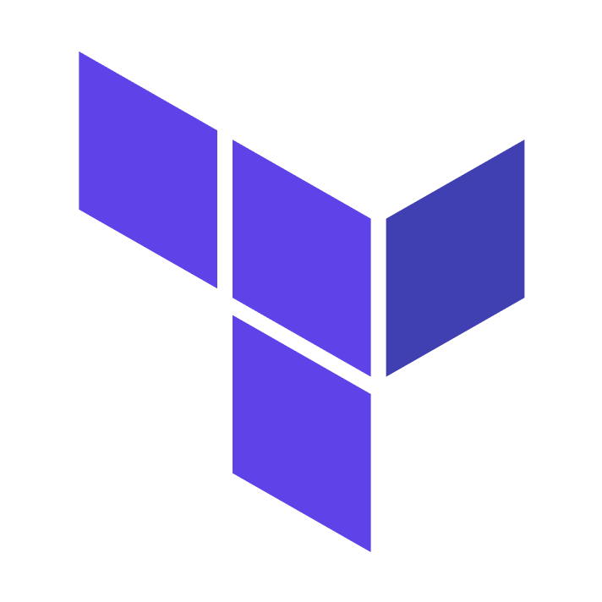



Cloud native apps are more than just
...
Base image
Code
Ports
Entrypoint
Dockerfile
...
PowerShell
Registries
Charts
Releases
Parameters
...
Pods
Secrets
Volumes
Services
Bash
On-premises
AKS
EKS
Machines
Bicep
Blob storage
S3
Disk
GitHub Actions
Event Hubs
SQS
Kafka
CosmosDB
DynamoDB
MongoDB
...
...
...
Terraform
Notes:
There’s more to apps than Kubernetes! There’s so much more we need to think about (messaging, proxies, container registries, API gateways).
We don’t develop in isolation anymore (and we really shouldn’t!!) To develop the type of complex apps that enterprises usually build, we need developers, platform engineers, and IT ops to collaborate. The tools that we use need to aid collaboration, not impede it.
- Platform engineers that support applications usually lack context about the architecture, while app developers lack context about the underlying cloud infrastructure. Together, we need a common understanding and visualization of what an application is.

Slide 8


#!/bin/bash
echo "Begin $app_name installation using Helm"
infras=(sql-data nosql-data rabbitmq keystore-data basket-data)
charts=(eshop-common basket-api catalog-api identity-api mobileshoppingagg ordering-api ordering-backgroundtasks ordering-signalrhub payment-api webmvc webshoppingagg webspa webstatus webhooks-api webhooks-web)
gateways=(apigwms apigwws)
if [[ !$skip_infrastructure ]]; then
for infra in "${infras[@]}"
do
echo "Installing infrastructure: $infra"
helm install "$app_name-$infra" --namespace $namespace --set "ingress.hosts={$dns}" --values app.yaml --values inf.yaml --values $ingress_values_file --values $ingressMeshAnnotationsFile --set app.name=$app_name --set inf.k8s.dns=$dns $infra --set inf.mesh.enabled=$use_mesh
done
fi
for chart in "${charts[@]}"
do
echo "Installing: $chart"
helm install "$app_name-$chart" --namespace $namespace --set "ingress.hosts={$dns}" --values app.yaml --values inf.yaml --values $ingress_values_file --values $ingressMeshAnnotationsFile --set app.name=$app_name --set inf.k8s.dns=$dns --set image.tag=$image_tag --set image.pullPolicy=$imagePullPolicy $chart --set inf.mesh.enabled=$use_mesh
done
{
"$schema": "https://schema.management.azure.com/schemas/2015-01-01/deploymentTemplate.json#",
"contentVersion": "1.0.0.0",
"parameters": {
"namespaceprefix": {
"type": "string",
"metadata": {
"description": "Name of the Redis namespace"
}
}
},
"variables": {
"location": "[resourceGroup().location]",
"namespaceprefix": "[concat(parameters('namespaceprefix'), uniqueString(resourceGroup().id))]",
"sbVersion": "2016-04-01"
},
"resources": [
{
"type": "Microsoft.Cache/Redis",
"name": "[variables('namespaceprefix')]",
"apiVersion": "[variables('sbVersion')]",
"location": "[variables('location')]",
"scale": null,
"properties": {
"redisVersion": "3.2.7",
"sku": {
"name": "Standard",
"family": "C",
"capacity": 1
},
"enableNonSslPort": true,
#!/bin/bash
CreateGroup()
{
echo Creating resource group $resource_group in '$location'
az group create --name $resource_group --location $location
}
deployresources()
{
echo Deploying ARM template '$path_and_filename.json' in resource group $resource_group
az group deployment create --resource-group $resource_group --parameters @$path_and_filename.parameters.json --template-file $path_and_filename.json
} path_and_filename=$1
resource_group=$2
if [ "$3" == "-c" ]; then
echo "Resource Group needs to be created"
if [ "$4" == "" ]; then
echo "but Resource Group name is missing"
exit 1
else
location=$4
CreateGroup
fi
fi
deployresources
echo “All resources finished successfully"
inf:
mesh:
enabled: false # True to enable Linkerd (set by deploy-all.ps1)
tls:
enabled: false # True to enable TLS (set by deploy-all.ps1)
issuer: "" # cert-manager issuer to use for retrieving certs (set by deploy-all.ps1)
sql: # inf.sql defines the sql server databases & logins
common:
host: https://**** # SQL host
user: sa # SQL user
pwd: ********** # SQL pwd
pid: Developer
catalog: # inf.sql.catalog: settings for the catalog-api sql (user, pwd, db)
db: CatalogDb # Catalog API SQL db name
ordering: # inf.sql.ordering: settings for the ordering-api sql (user, pwd, db)
db: OrderingDb # Ordering API SQL db name
identity:
db: IdentityDb # Ordering API SQL db name
webhooks:
db: WebhooksDb # Webhooks DB
mongo:
host: ********** # Uncomment to use specify custom mongo host. By default nosql-data is used
redis: # inf.redis defines the redis' connection strings
basket:
svc: basket-data # Name of k8s svc for basket redis
constr: ******** # Connection string to Redis used by Basket API
keystore:
svc: keystore-data # Name of k8s svc for keystore-data redis
constr: ********** # Connection string to Redis used as a Keystore (by Identity API)
eventbus:
svc: rabbitmq # Name of k8s svc for rabbitmq
constr: ******** # Event bus connection string
useAzure: true # true if use Azure Service Bus. False if RabbitMQ
appinsights:
key: "" # App insights to use
{{- $name := include "catalog-api.fullname" . -}}
{{- $cfgname := printf "%s-%s" "cfg" $name -}}
apiVersion: apps/v1
kind: Deployment
metadata:
name: {{ template "catalog-api.fullname" . }}
labels:
ufo: {{ $cfgname}}
app: {{ template "catalog-api.name" . }}
chart: {{ template "catalog-api.chart" . }}
release: {{ .Release.Name }}
heritage: {{ .Release.Service }}
spec:
replicas: {{ .Values.replicaCount }}
selector:
matchLabels:
app: {{ template "catalog-api.name" . }}
release: {{ .Release.Name }}
template:
metadata:
labels:
app: {{ template "catalog-api.name" . }}
release: {{ .Release.Name }}
{{ if .Values.inf.mesh.enabled -}}
annotations:
linkerd.io/inject: enabled
{{- end }}
spec:
{{ if .Values.inf.registry -}}
imagePullSecrets:
- name: {{ .Values.inf.registry.secretName }}
{{- end }}
containers:
- name: {{ .Chart.Name }}
{{ if .Values.probes -}}
{{- if .Values.probes.liveness -}}
Notes:
Different tools may be used to deploy different components of your application.
A colleague of mine talks about infrastructure as code balloons, where organizations will use different tools and frameworks to deploy their applications, and it’s a just a glorious spaghetti mess of scripts that barely hold together.
This is a big problem. It’s not just a that having different tools makes life harder for your platform engineers who are responsible for maintaining your deployment pipelines, we also need to factor in software engineers who are trying to build new applications or features for your organization.
Infrastructure-as-code balloons cost time and money, and introduce unnecessary complexity.

Slide 9
Cloud-native application platform
that works on any cloud
Notes:
“Radius is an open-source, cloud-native application platform that enables developers and operators to develop and collaborate on cloud native apps across public and private clouds”

Slide 10
Team
Collaboration
Infrastructure Recipes
Application
Graph
Cloud
Neutral
Radius Application and Environments allow developers to work with operations on application definition + delivery
Swappable infrastructure with popular IaC tools that follows org best practices and IT policy
by default
Understand
how services and infrastructure in an application are interconnected
Deploy across development, on-premises, and cloud environments with a consistent experience
Notes:
Developers define applications and dependencies
Operators define environments .
Radius brings them together, deploying apps and infra that meet both requirements.
Mention recipies at a high level
Radius applications are the primary resource that brings all your services, dependencies and relationships together.
It gives you a single description of your application, allowing you to deploy and manage your application easily.
Radius applications capture this via an Application graph, which helps us deploy and understand our applications better.
- Radius applications are designed to be cloud and platform agnostic.
- Once you define your application, you can deploy it to any cloud or platform that Radius supports. (Currently just Azure + AWS)
- This is great if we need to move our app between clouds, or between cloud and on-prem environments.
- Developers can define their requirements and dependencies, and operators can define their environments and Recipes that bind those requirements to the appropriate cloud resources.

Slide 11

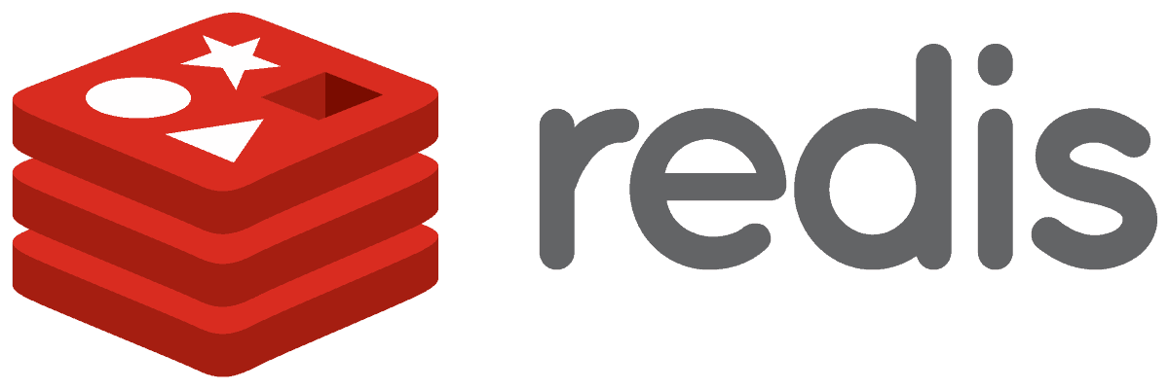
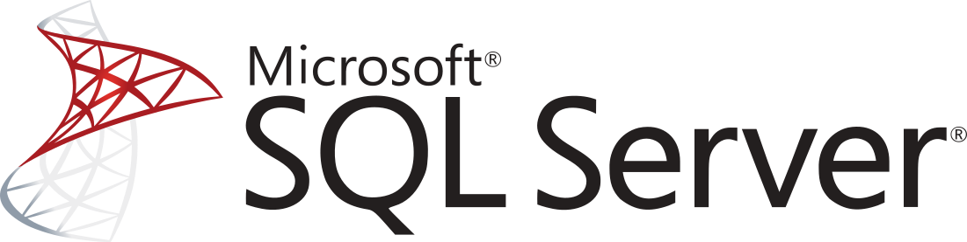




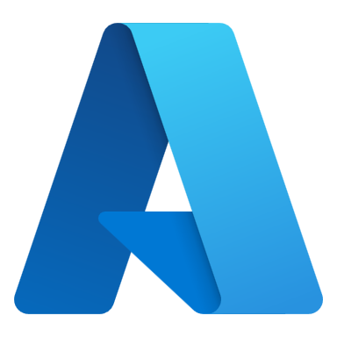
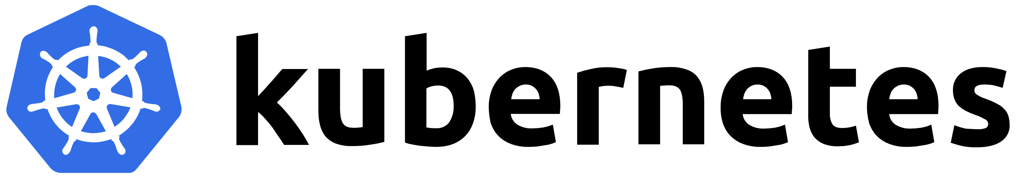


Cloud-native applications
containing
Team
Collaboration
Infrastructure Recipes
Application
Graph
Cloud
Neutral
Any cloud or edge infrastructure
Notes:
So from a Platform Engineering perspective, Radius provides a standardized and repeatable framework for platform engineering. It focuses on enabling platform teams to create internal developer platforms (IDPs) with a particular emphasis on making platform operations simpler, automated, and more efficient.
The idea is to help platform teams better manage, maintain, and improve their cloud-native platforms, abstracting away the complexity of operating underlying infrastructure.

Slide 12

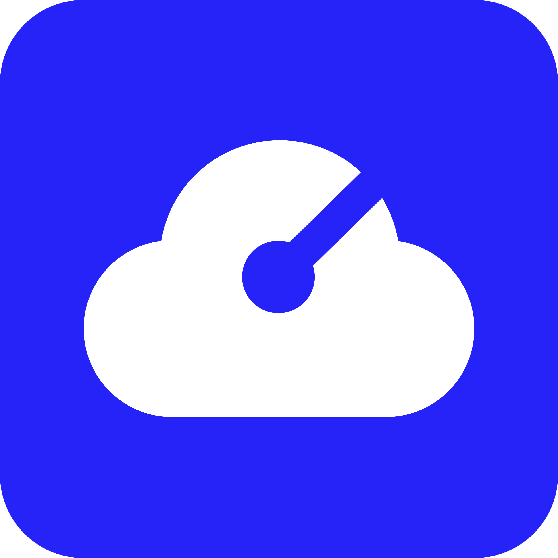




Application
Internet
Gateway
Frontend
Container
Backend
Container
Redis
Cache
SQL
Database
Notes:
Let’s go through an example, Say we’re building a e-commerce website (always seems to be the go to when talking about example microservices architecture)
We might have a container for our frontend, that talks to a backend container and a redis cache, which also uses a SQL database

Slide 13

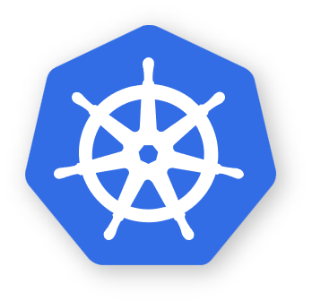


Application
Environment
Internet
Gateway
RECIPES
Redis
Container
SQL
Container
Frontend
Container
RECIPES
Local development
Backend
Container
Redis
Cache
COMPUTE
CNCF-certified
Kubernetes
SQL
Database
Environment
RECIPES
Azure Cache
for Redis
Azure
SQL DB
COMPUTE
Azure
Kubernetes Service
Notes:
When developing locally, we can use Radius in a local environment for dev/test purposes. We can provision local containers for this purpose.

Slide 14

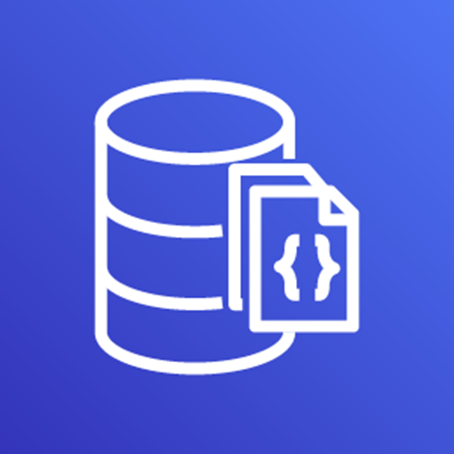

Environment
RECIPES
Redis
Container
SQL
Container
Local development
COMPUTE
CNCF-certified
Kubernetes
Application
Environment
Internet
Gateway
RECIPES
Azure Cache
for Redis
Azure
SQL DB
Frontend
Container
RECIPES
Backend
Container
Redis
Cache
COMPUTE
Azure
Kubernetes Service
SQL
Database
Environment
RECIPES
AWS
MemoryDB
AWS
DocumentDB
COMPUTE
Elastic
Kubernetes Service
Notes:
When it comes time to deploying our applications, environments map to whichever cloud environment that we’re deploying to via recipes.
So when we’re deploying to production, this becomes a Redis Cache deployed in Azure, Azure SQL database, and an AKS cluster.

Slide 15
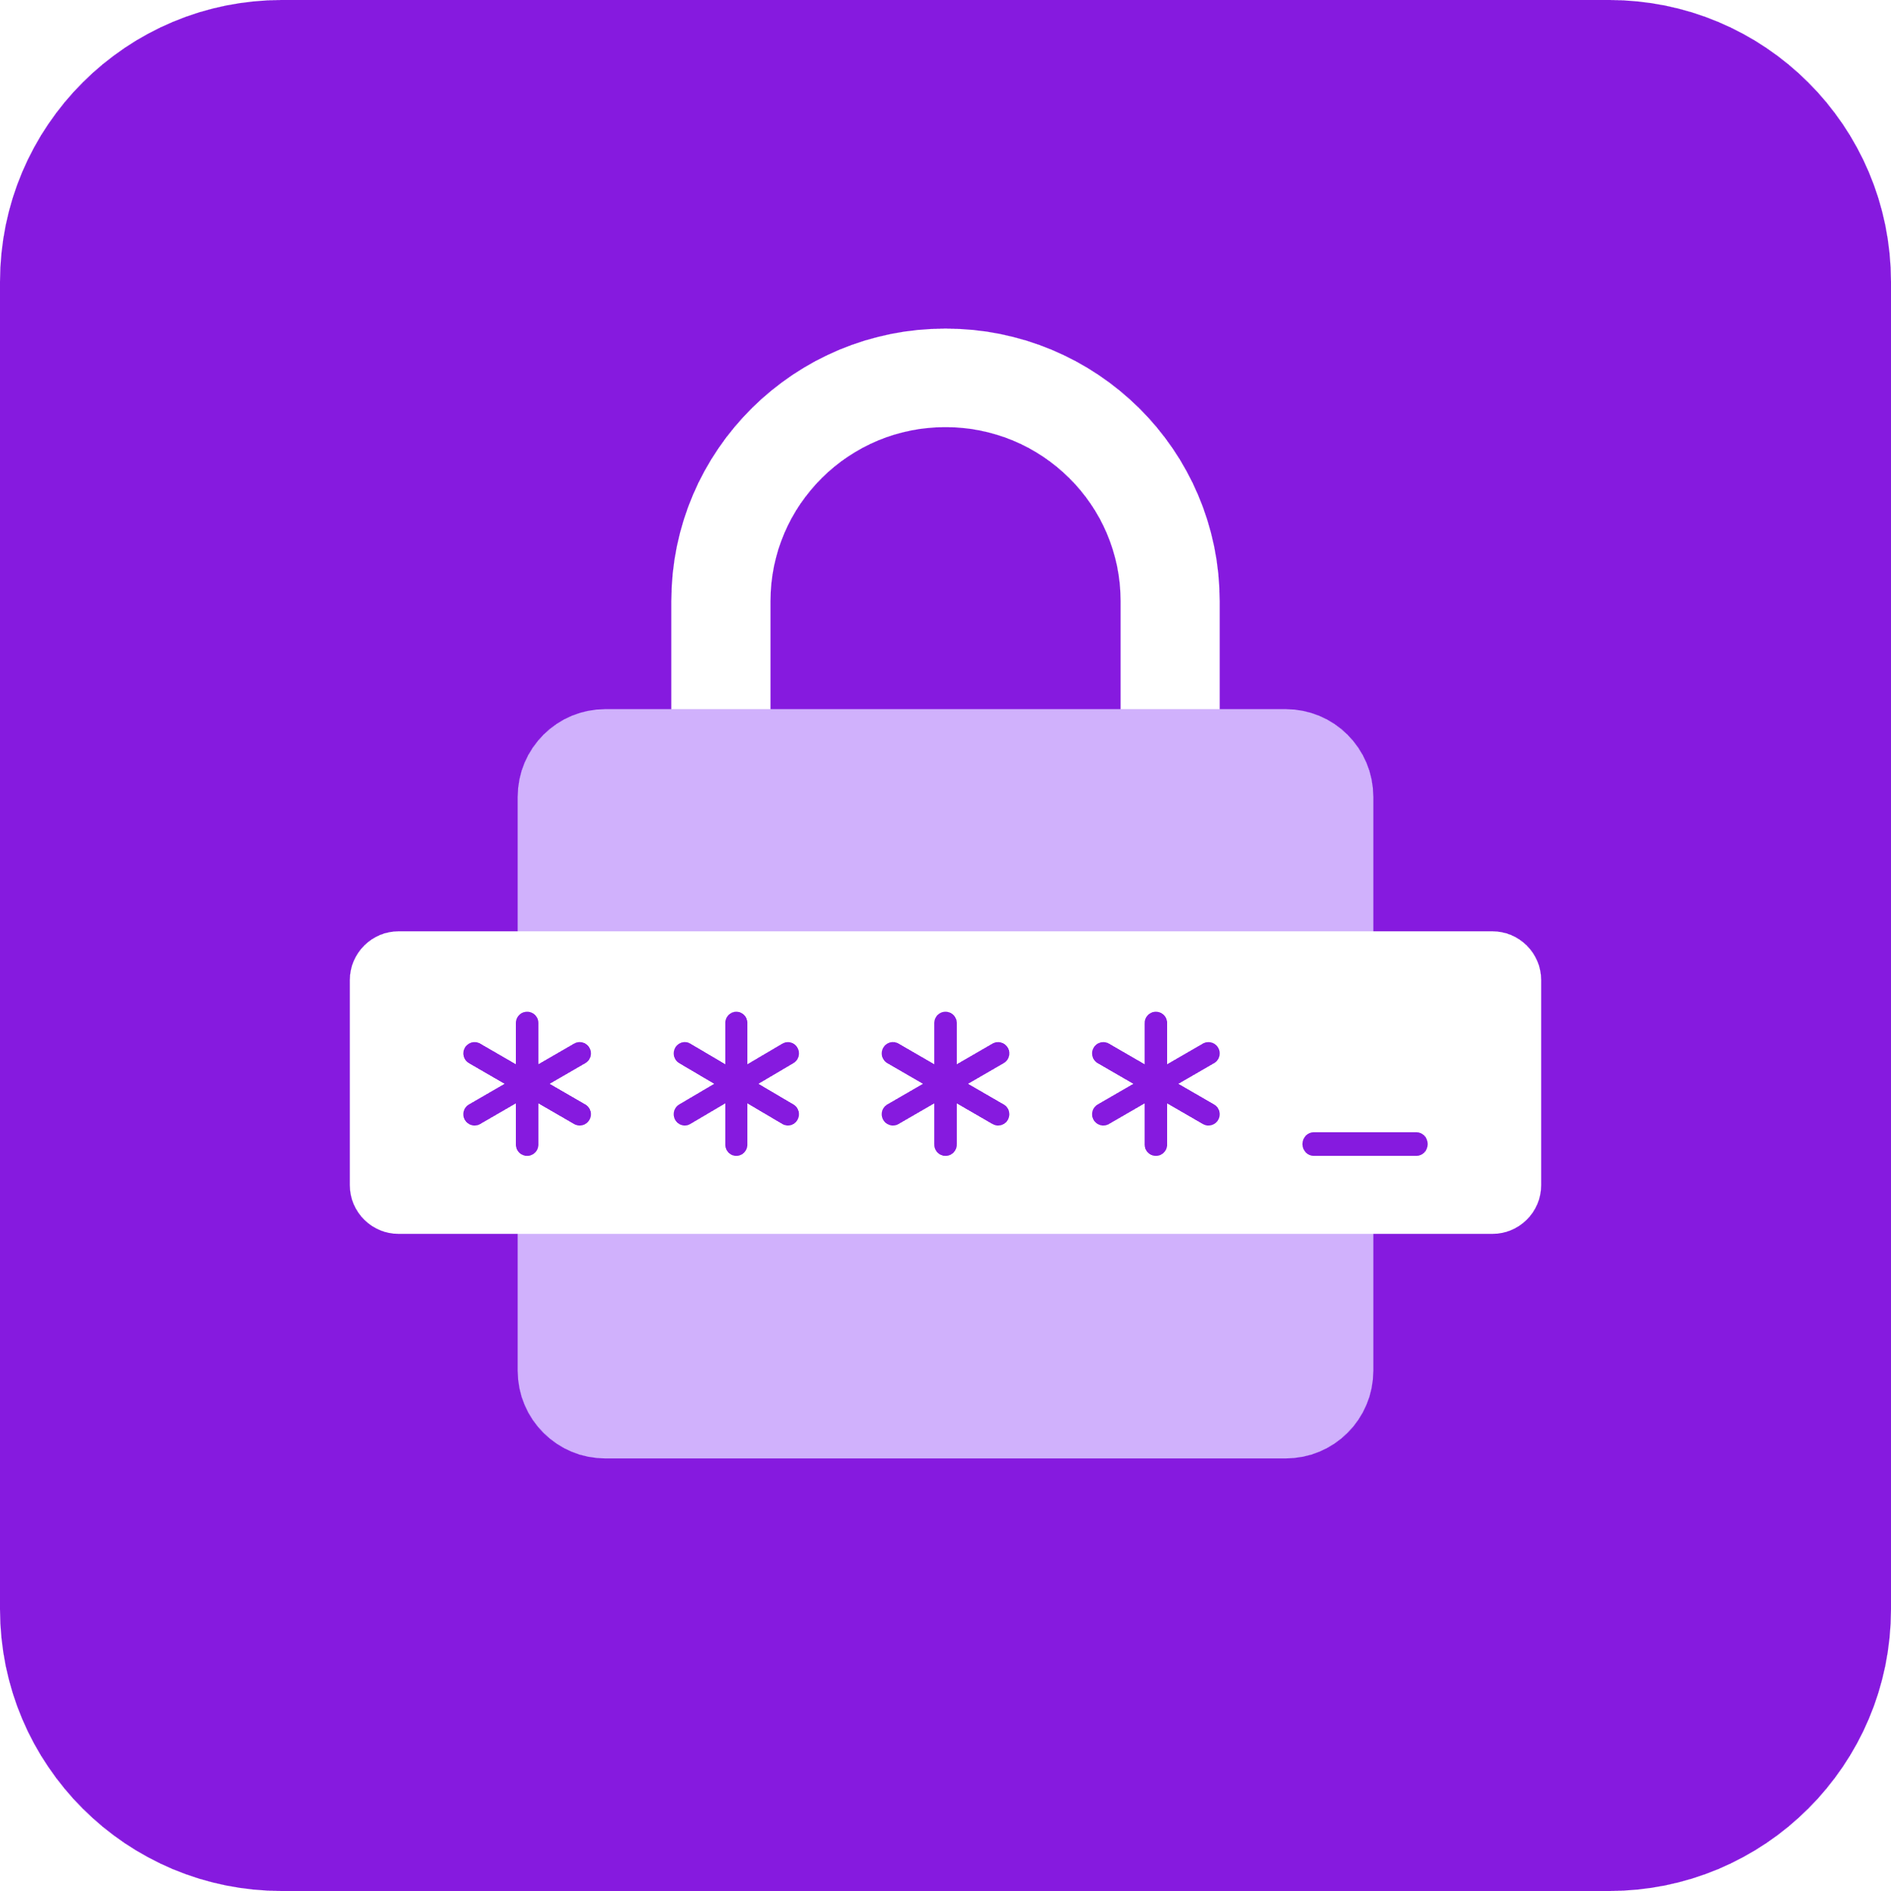




Application
Core
resources
Container
Connection
Gateway
Secret Store
Standard resources
Redis
Mongo
SQL
Dapr
RabbitMQ
Extensible
Any cloud or on-premises resource
Azure
AWS
Kubernetes
Any platform
Environment
RECIPES
On-premises
Notes:
So think about some of the core resources that you have as part of your cloud-native architectures

Slide 16
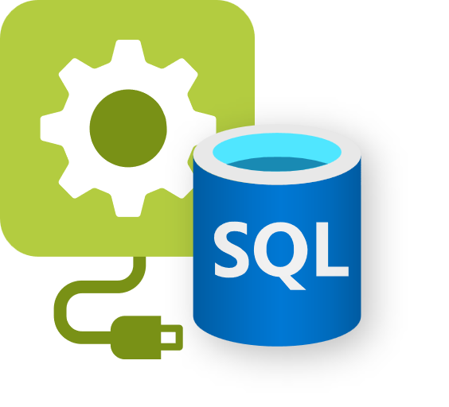

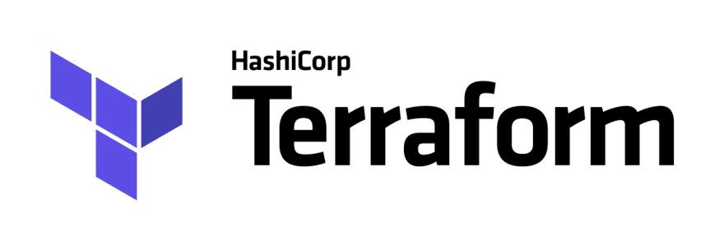
Recipes
Azure
SQL DB
Container
SQL DB
AWS RDS
SQL Edge
Container
Services access consistent connection strings and values
Infrastructure automatically deployed and configured
Leverage your existing IaC templates
Bicep
Extensible…
Notes:
- Recipes enable a separation of concerns between IT operators and developers by automating infrastructure deployment.
- Developers select the resources they want in their apps, and Platform Engineers will codify in their environment how these resources should be deployed and configured.
- So when a developer deploys their application and its resources, Recipes automatically deploy the backing infrastructure and bind it to the developer’s resources.
- Currently, recipes support both Bicep and Terraform. You can use Recipes that Radius provides, or you can create your own custom recipes.

Slide 17
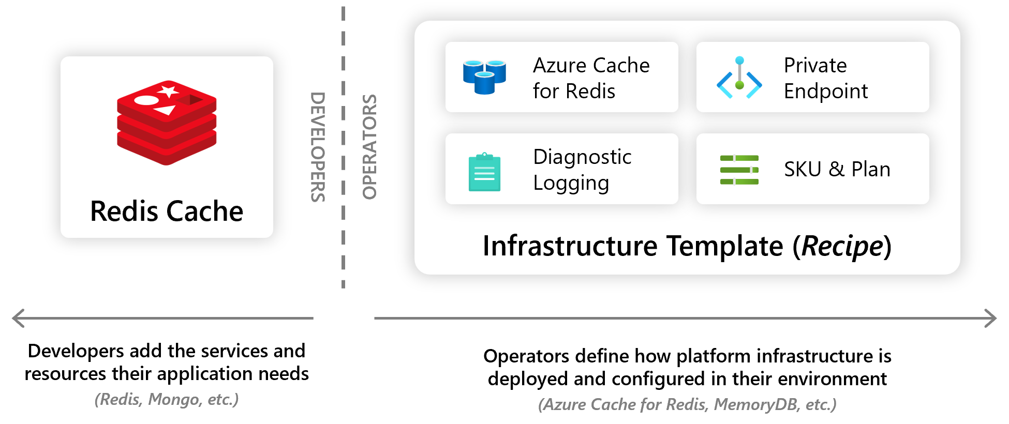
Notes:
So in this example, I’m building an application and in that I want to use a cache. As a developer, I can define in my Radius application that I want to use a cache, so I can define that as a resource in my app.
What IT Operators and Platform Engineers will do, is codify how this cache should be deployed and configured. So in this example, this cache will be deployed onto Azure. We’re integrating it into a VNET, so we need a private endpoint for it. We may also want to enable diagnostic logging for the cache as well.
When a developer deployes their application and its resources, Recipes automatically deploy the backing infrastructure and bind it to the developer’s resources. Let’s build an app that uses a recipe.

Slide 18
Wait? Is this similar to Crossplane?
Radius focuses on helping platform engineers create, automate, and operate internal developer platforms.
Emphasizes operational consistency, automation, and self-service for developers.
Crossplane focuses more on infrastructure provisioning and management.
Notes:
Crossplane Enables platform teams to build and manage their own internal cloud platform by extending Kubernetes. It allows users to provision and manage cloud infrastructure (such as databases, networks, compute, etc.) declaratively using Kubernetes.
Radius provides a standardized and repeatable framework for platform engineering. It focuses on enabling platform teams to create internal developer platforms (IDPs) with a particular emphasis on making platform operations simpler, automated, and more efficient.

Slide 19


Platform Engineering with Radius
Developers define application requirements and business logic
Operators define infrastructure security, cost, and compliance
Applications
Environments
Recipes
On-premises
Notes:
- Environments in Radius provide a landing-zone for apps that’s configured with the organizations chosen best-practices, settings, and Recipes.
- They encapsulate and store configuration for the compute platform, networking configuration, diagnostics, and other operational concerns.
- You can configure environments to vary across different types of deployments (like staging, production), deployment regions or even different clouds.
- Platform Engineers collaborate with app developers by managing the set of environments that developers can use
- When an app is deployed, Radius will bind the app to the configuration of the target environment, and apply the relevant settings.
Operational configuration in the environment increases developer velocity because the app doesn’t need to change when it’s deployed across environments.

Slide 20
Radius Environments + Applications
Notes:
Alright let’s jump into a demo

Slide 21
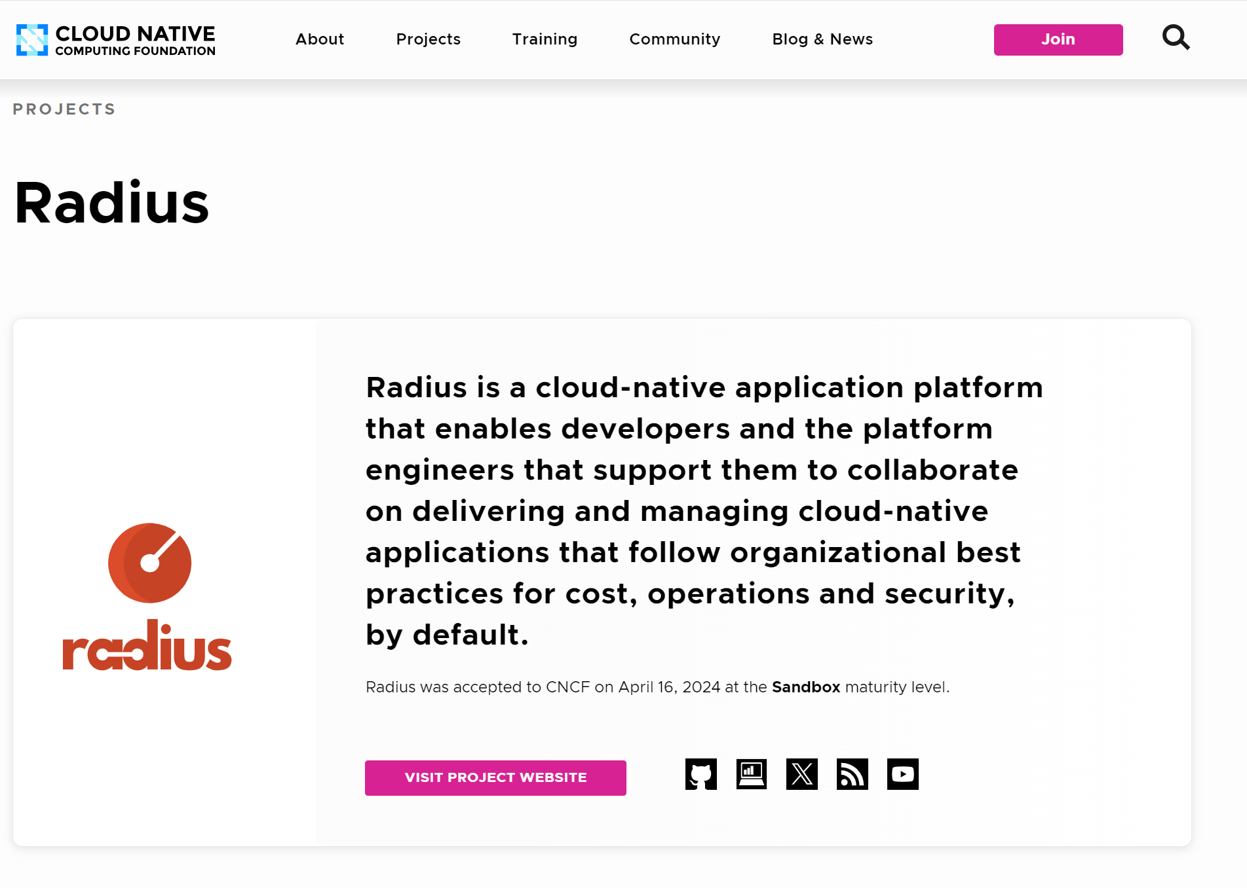
CNCF Sandbox Project
https://www.cncf.io/projects/radius/

Slide 22



Radius Community
aka.ms/radius/discord
aka.ms/radius/community-call
aka.ms/radius-office-hours
aka.ms/radius/community-call

Slide 23


radapp.io
github.com/radius-project

Slide 24



Thanks for listening
willvelida.com
github.com/willvelida
twitter.com/willvelida
linkedin.com/in/willvelida
youtube.com/@willvelida

